Slide 1
CS2100
28 Feb 2025
Revision #1
(Prepared by: Aaron Tan)

Slide 2
Contents:
AY2024/25 Sem1 Midterm Test
AY2023/24 Sem2 Midterm Test

Slide 3
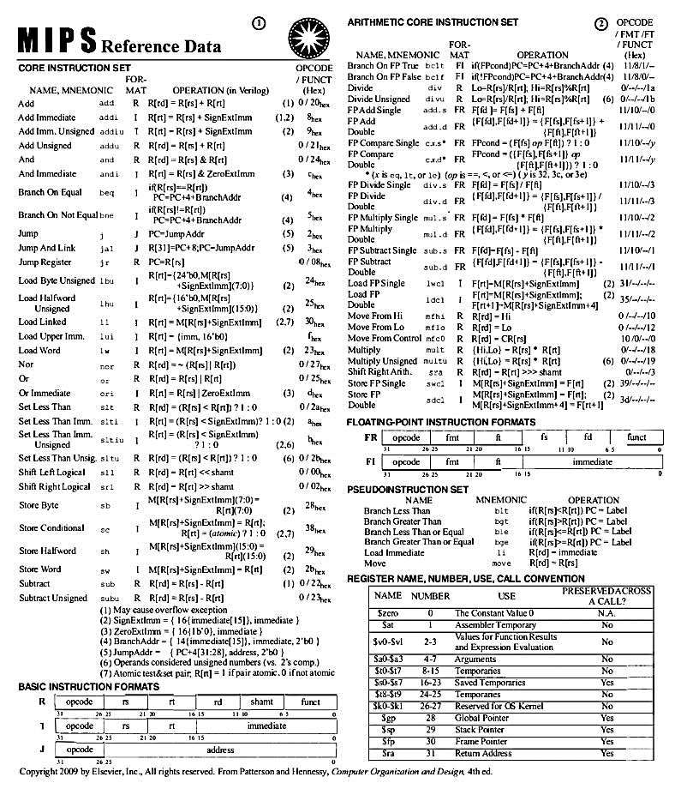
Important:
Date: 12 March 2025, Wednesday
Time: 7 – 8:30pm
Venue: MPSH2B
Provided:
MIPS Reference Data Sheet (page 1)
Format:
20 MCQs (20 marks)
4 FITBs (20 marks)
Remember to bring:
Student Card (or Photo-ID)
Pencil (2B or above), eraser, writing papers, calculator

Slide 4
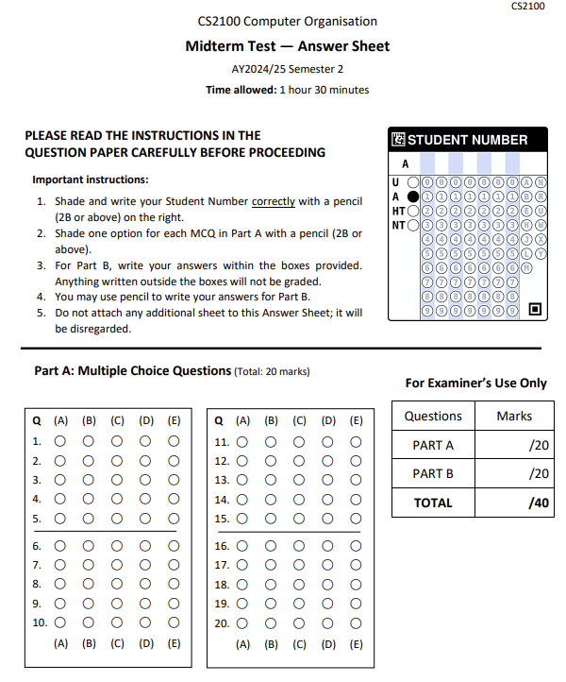
Answer Sheet (page 1)
Write your Student Number here.
0123456R
Shade your Student Number here.
(Check that it is correct!)
Use PENCIL (2B or above)!!!
Shade your MCQ answers.

Slide 5
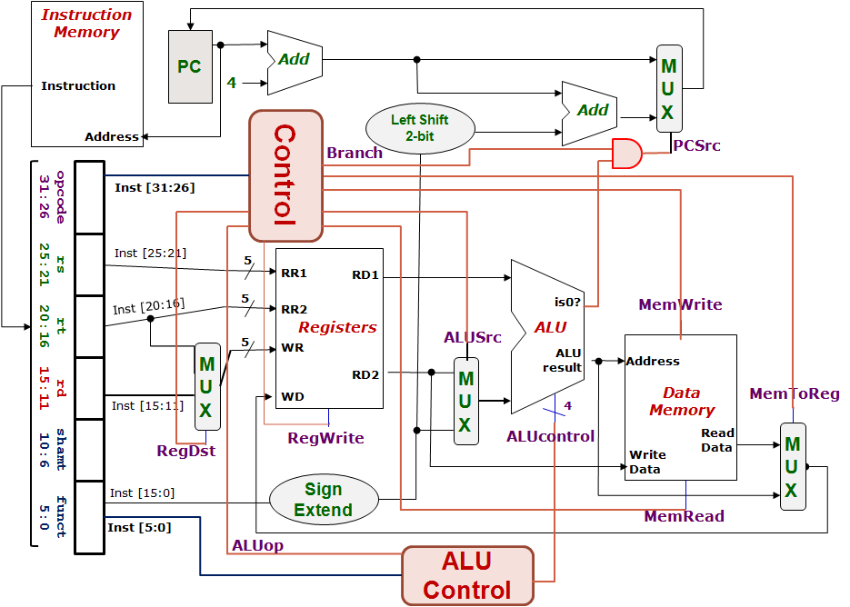
5. Control Design: Outputs
 | RegDst | ALUSrc | MemToReg | Reg Write | Mem Read | Mem Write | Branch | ALUop
 |  |  |  |  |  |  |  | op1 | op0
R-type
lw
sw
beq
1
0
0
1
0
0
0
1
0
0
1
1
1
1
0
0
0
0
X
1
X
0
0
1
0
0
0
X
0
X
0
0
0
1
0
1
0
1
0
1
0
1
1
0


Slide 6
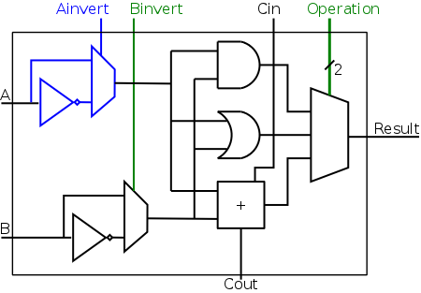
5. One Bit At A Time (Aha!)
Can you see how the ALUcontrol (4-bit) signal controls the ALU?
Note: implementation for slt not shown
ALUcontrol |  |  | Function
Ainvert | Binvert | Operation
0 | 0 | 00 | AND
0 | 0 | 01 | OR
0 | 0 | 10 | add
0 | 1 | 10 | subtract
0 | 1 | 11 | slt
1 | 1 | 00 | NOR
Acknowledgement: Image taken from NYU Course CSCI-UA.0436

Slide 7
5. Two-level Implementation
Step 1.
Generate 2-bit ALUop signal from 6-bit opcode.
6
Control
Step 2.
Generate ALUcontrol signal from ALUop and optionally 6-bit Funct field.
ALUop
2
00: lw, sw
01: beq
10: add, sub, and, or, slt
opcode
31:26
rs
25:21
rt
20:16
rd
15:11
shamt
10:6
funct
5:0
ALU
4
ALUcontrol
0000: and
0001: or
0010: add
0110: sub
0111: set on less than
ALU Control
6

Slide 8
5. Generating ALUcontrol Signal
Opcode | ALUop | Instruction Operation | Funct field | ALU action | ALU control
lw |  | load word |  | add
sw |  | store word |  | add
beq |  | branch equal |  | subtract
R-type |  | add |  | add
R-type |  | subtract |  | subtract
R-type |  | AND |  | AND
R-type |  | OR |  | OR
R-type |  | set on less than |  | set on less than
Instruction Type | ALUop
lw / sw | 00
beq | 01
R-type | 10
00
xxxxxx
0010
00
xxxxxx
0010
01
xxxxxx
0110
10
10 0000
0010
10
10 0010
0110
10
10 0100
0000
ALUcontrol | Function
0000 | AND
0001 | OR
0010 | add
0110 | subtract
0111 | slt
1100 | NOR
10
10 0101
0001
10
10 1010
0111
Generation of 2-bit ALUop signal will be discussed later


Slide 9
5. Design of ALU Control Unit (1/2)
Input: 6-bit Funct field and 2-bit ALUop
Output: 4-bit ALUcontrol
Find the simplified expressions
ALUcontrol3 = 0
ALUcontrol2 = ?
ALUop0 + ALUop1⋅ F1
 | ALUop |  | Funct Field ( F[5:0] == Inst[5:0] ) |  |  |  |  |  | ALU control
 | MSB | LSB | F5 | F4 | F3 | F2 | F1 | F0
lw
sw
beq
add
sub
and
or
slt
0
0
X
X
X
X
X
X
0 0 1 0
0
0
X
X
X
X
X
X
0 0 1 0
X
0
1
X
X
X
X
X
X
0 1 1 0
1
0
1
0
0
0
0
0
0 0 1 0
X
X
X
1
0
1
0
0
0
1
0
0 1 1 0
X
X
X
1
0
1
0
0
1
0
0
0 0 0 0
X
X
X
1
0
1
0
0
1
0
1
0 0 0 1
X
X
X
1
X
X
X
0
1
0
1
0
1
0
0 1 1 1


Slide 10
5. Design of ALU Control Unit (2/2)
Simple combinational logic
Note: We will revisit this when we cover combinational circuits later.
ALUop
2
ALU Control block
ALUcontrol2
= ALUOp0 + ALUOp1∙F1
ALUOp0 (LSB)
ALUOp1 (MSB)
ALUcontrol3
0
ALUcontrol2
F3
ALUcontrol1
ALUcontrol
F2
F(5-0)
F1
ALUcontrol0
F0

Slide 11
Datapath & Control
Instruction
Memory
PC
Add
MUX
Instruction
4
0
1
Left Shift 2-bit
Add
Address
PCSrc
Control
Branch
Inst [31:26]
Inst [25:21]
5
RR1
RD1
Inst [20:16]
5
RR2
is0?
MemWrite
Registers
ALUSrc
ALU
opcode
31:26
rs
25:21
rt
20:16
rd
15:11
shamt
10:6
5
funct
5:0
WR
ALU
result
0
1
MUX
Address
RD2
0
1
MUX
WD
Data
Memory
MemToReg
Inst [15:11]
4
RegWrite
ALUcontrol
Read
Data
MUX
RegDst
Write
Data
1
0
Inst [15:0]
Sign Extend
Inst [5:0]
MemRead
ALUop
ALU Control

Slide 12
AY2024/25 Semester 1

Slide 13
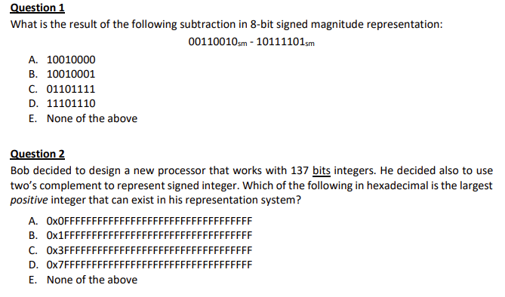
AY2024/25 Semester 1
00110010₂
+ 00111101₂
= 01101111₂
Taking away one bit for the sign bit, we are left with 136 bits. This gives nicely 34 hexadecimals ‘F’s – which will be the largest positive integer.

Slide 14
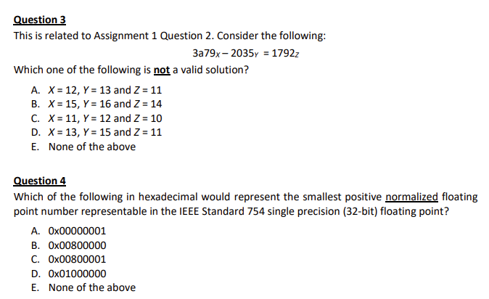
AY2024/25 Semester 1
No easy way. Have to try every option.
(A) 3a79₁₂ = 6717₁₀ ; 2035₁₃ = 4438₁₀ ; 6717 - 4438 = 2279;
1792₁₁ = 2279₁₀
(B) 3a79₁₅ = 12489₁₀ ; 2035₁₆ = 8245₁₀ ; 12489 - 8245 = 4244;
1792₁₄ = 4244₁₀
(C) 3a79₁₁ = 5289₁₀ ; 2035₁₂ = 3297₁₀ ; 5289 - 3297 = 1792;
1792₁₀ = 1792₁₀
(D) 3a79₁₃ = 8381₁₀ ; 2035₁₅ = 6800₁₀ ; 8381 - 6800 = 1581;
1792₁₁ = 2279₁₀
Sign = 0; Exponent = 1; Mantissa = 0.
0b0 00000001 00000000000000000000000
= 0x00800000
(Note: All 0s are reserved for special value 0.)
During the Zoom session, a student brought up that exponent = 0 represents special value. He is right. Exponent = 0 or 255 represent special values like 0, infinity, NAN, etc.
Therefore the answer is not (A).

Slide 15
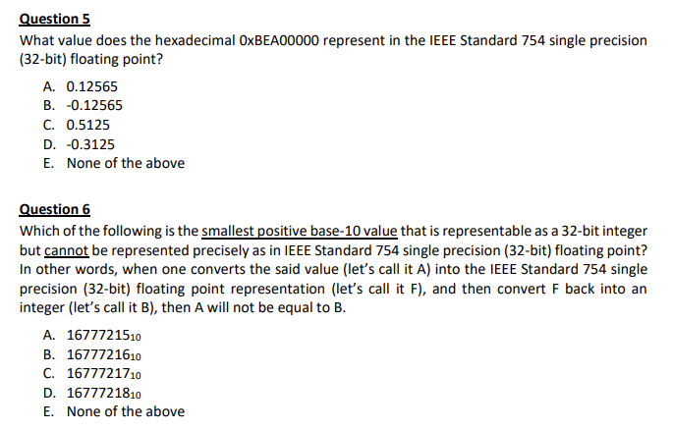
AY2024/25 Semester 1
0xBEA00000 = 0b1011 1110 1010 0000 0000 0000 0000 0000
Exponent = 125 – 127 = -2.
-1.01₂ × 2⁻² = -0.0101₂ = - 0.3125
We have only 23 bits in the mantissa of the IEEE standard 754 to represent an integer. We do have an additional implicit “1”. So if we have a number (in binary) that starts with a ‘1’ followed by 23 ‘0’s – and then a ‘1’ (a 25-bit number), then even utilizing the implicit ‘1’ at the MSB, we still need 24 bits – one more than what we have. Hence this integer will not be representable. This number is 0x1000001, which is 16777217₁₀ .

Slide 16
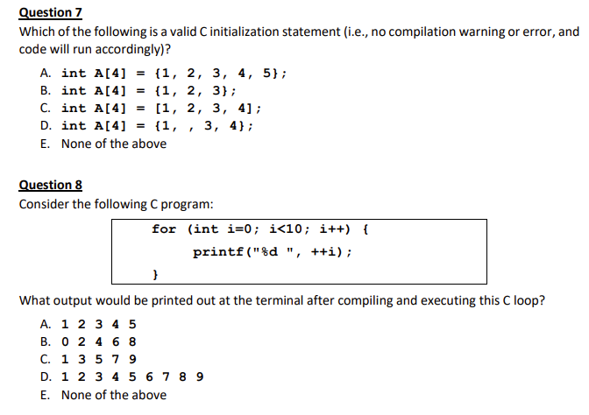
AY2024/25 Semester 1
There are two increments of i.
What is printed is the pre-incremented i.

Slide 17
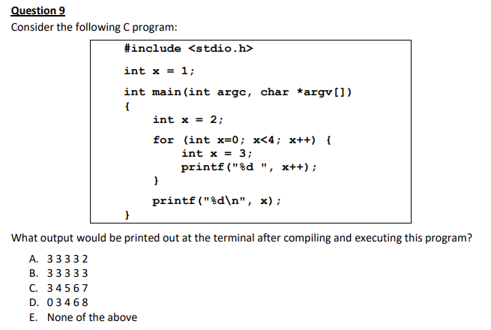
AY2024/25 Semester 1
The innermost printf() prints its local variant of x – which is always initialized to 3. So 4 “3”s will be printed, even though x is post-incremented in the printf() because each time round this loop, a new x is instantiated. The final printf() prints the variant of x that is local to main() and which scopes out the global x. Hence it prints “2”.

Slide 18
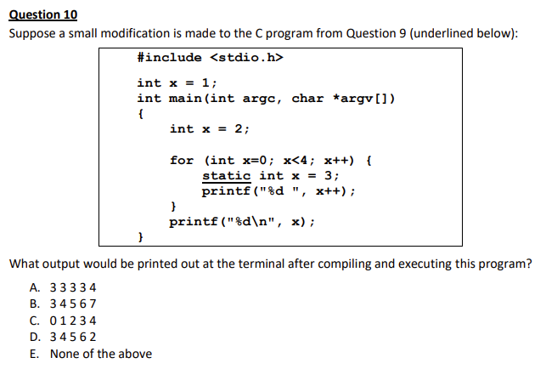
AY2024/25 Semester 1
Here, the big difference is in the innermost printf() prints its local variant of x is now declared as “static”. This means that there shall be only one instance of it. This will result in this same instance being incremented each time round the loop.

Slide 19
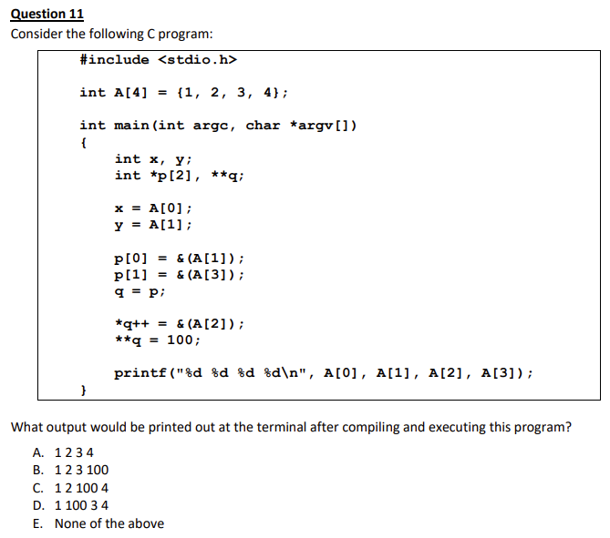
AY2024/25 Semester 1
q was initially pointing at p[0].
After the “*q++”, it points to p[1] (while modifying p[0] to point to A[2]) which contains the address of A[3].
The double dereferencing therefore changed what p[1] points to which is namely, A[3].

Slide 20
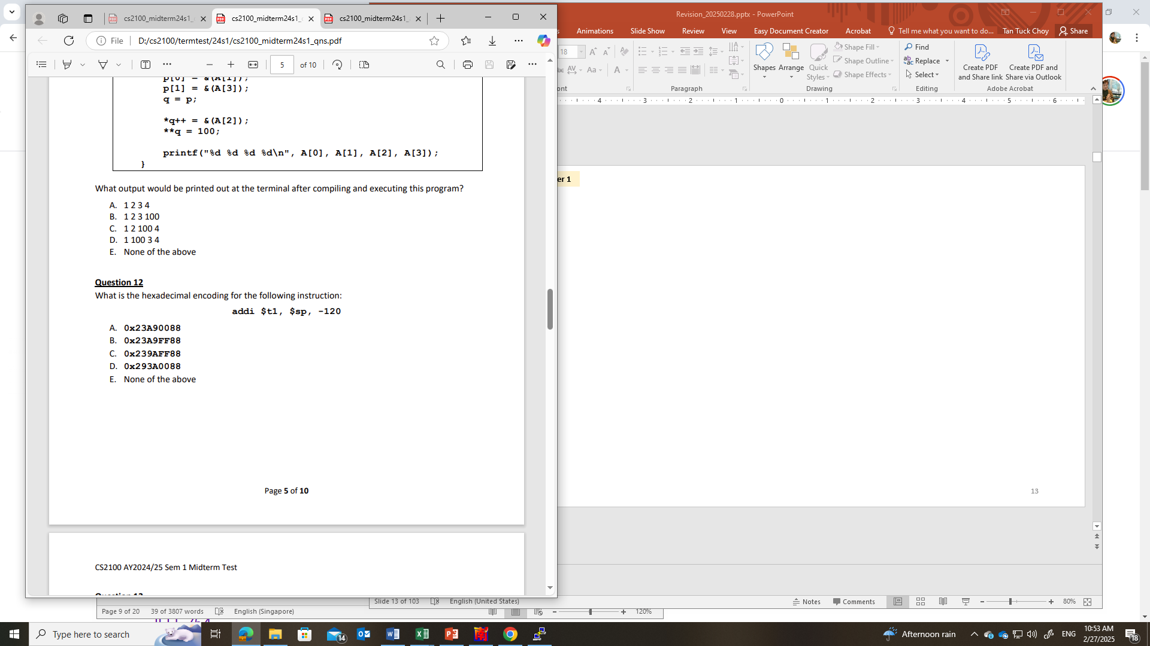
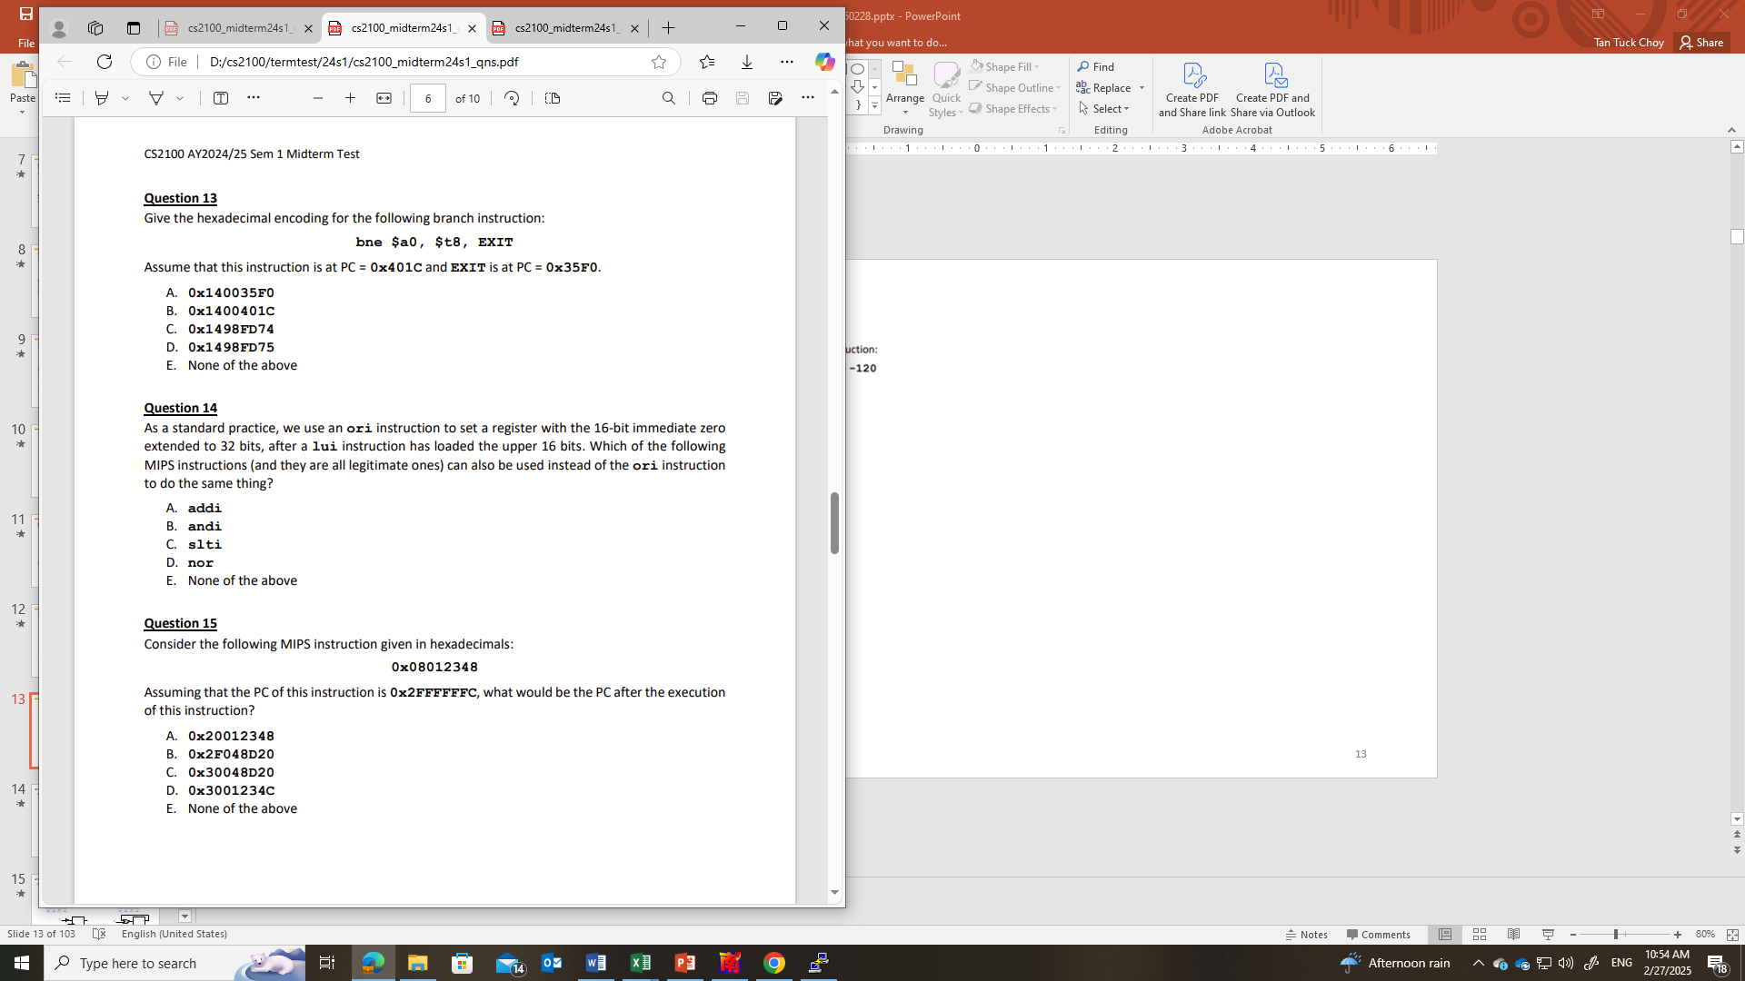
AY2024/25 Semester 1
addi = 0b001000; $sp = $29 = 0b11101; $t1 = $9 = 0b01001;
-120 = 0b1111111110001000 = 0xFF88
bne = 0b000101; $a0 = $4 = 0b00100; $t8 = $24 = 0b11000
PC+4 = 0x4020. So the constant for the bne is (0x35F0 – 0x4020)/4 = 0xFD74 (16 bits two’s complement).
We cannot use addi because the immediate will be sign extended, which may result in ‘1’s in the upper 16 bits and this will affect the upper bits.
We cannot use andi because the lower 16 bits after lui is 0. And and’ing anything to it will still be zero.
We cannot use slti because the result is a comparison true (1) or false (0).
We cannot use nor because there is no immediate. We will need additional operations and that will complicate things.

Slide 21
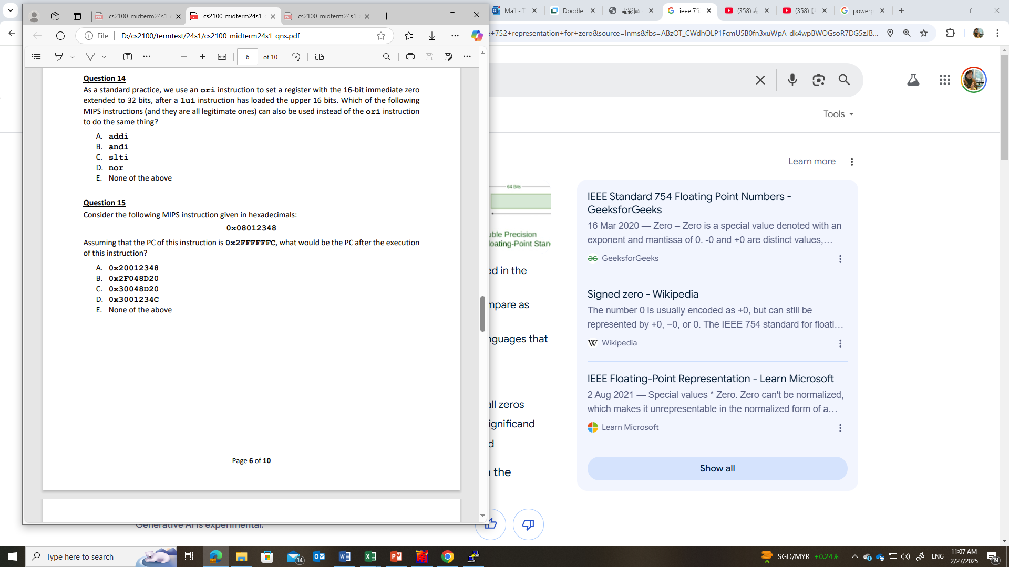
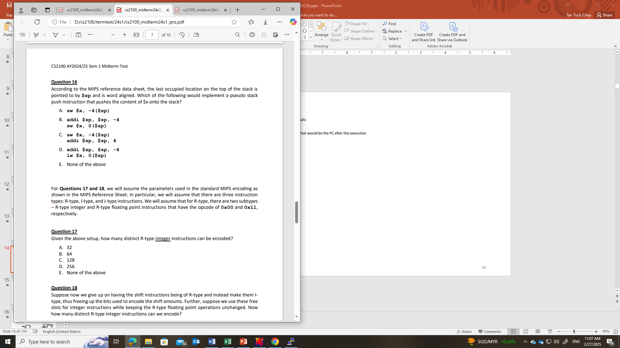
AY2024/25 Semester 1
This is a j instruction.
The address bits from the instruction are 0x012348. We multiply this by 4 to get 0x48D20.
PC+4 = 0x30000000. Appending this to the upper 4 bits of the PC yields the resultant PC of 0x30048D20.
The stack pointer first has to be decremented (since the stack grows towards the lower addresses) to yield an empty word before a sw is used to store it.

Slide 22
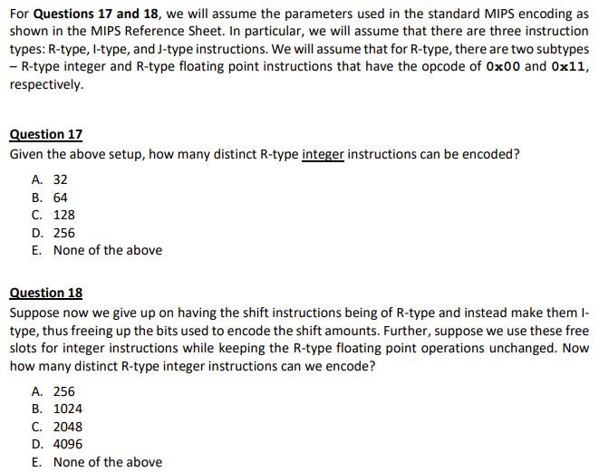
AY2024/25 Semester 1
For each R-type instruction opcode, we have 6-bits of func code that yields 64 instructions.
This would simply extend the func code to 11 bits and that will yield 2048 instructions

Slide 23
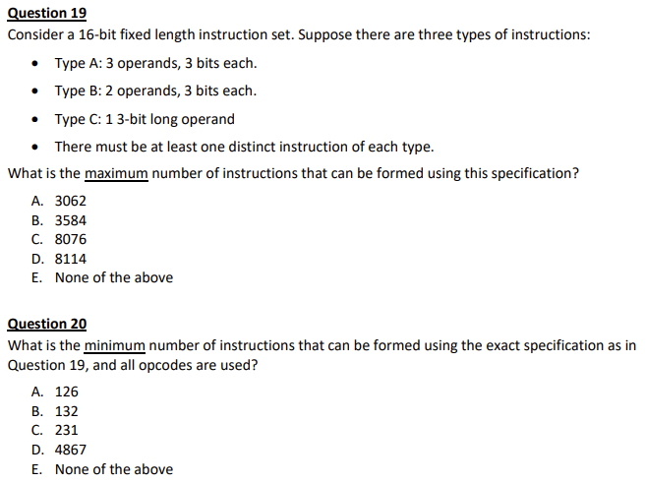
AY2024/25 Semester 1
Length of opcode: Type A = 7 bits, type B = 10 bits, type C = 13 bits.
To maximize, we should have just 1 Type A, 1 Type B, and give all the opcode bits to Type C. We can have 3-tier opcode field with 7 bits for the first opcode, 3 bits for the next and another 3 bit for the third level. We can reserve 0000000₂ to be the opcode for the only Type A instruction. Then we can use 0000001000₂ for the only Type B instruction. Then the second level opcode of 0000001001₂ onwards can be used for Type C. From 0000001001₂ to 1111111111₂ there are 1014 slots. Each of these will allow for another 8 slots (000₂-111₂) at the third level. This yields 1014 x 8 = 8112. So the maximum would be 8112 + 1 Type A + 1 Type B = 8114.
Corrected answer: Type A =1; Type B = 1; Type C = 1015 × 8 = 8120; total = 8122.
Type A: 0000000₂ to 1111110₂ → 127 instructions.
Type B: 1111111 000 to 1111111 110 → 7 instructions.
Type C: 1111111 111 xxx → 8 instructions.
Total: 127 + 7 + 8 = 142 instructions.

Slide 24
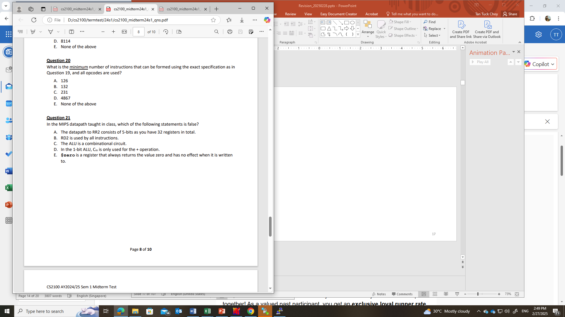
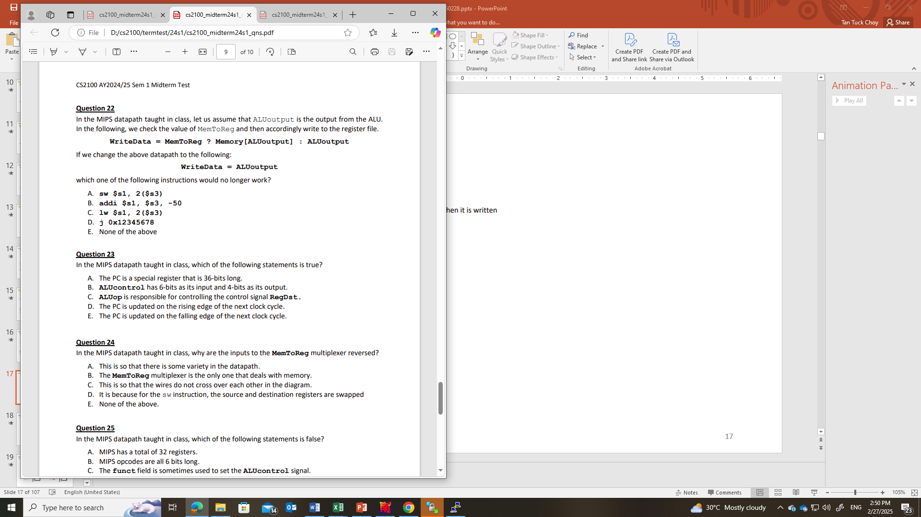
AY2024/25 Semester 1
RD2 is not used by the lw and sw instructions.
The lw instruction needs the value from memory and can’t just do with the ALUoutput.

Slide 25
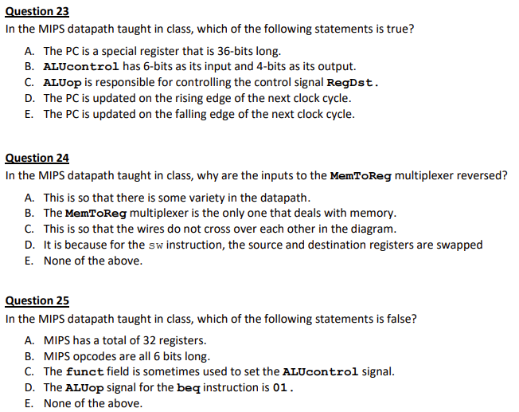
AY2024/25 Semester 1
From the definition of the clock and when the update to PC happens during the cycle.
This is mainly to do with the diagram and to keep it clean.

Slide 26
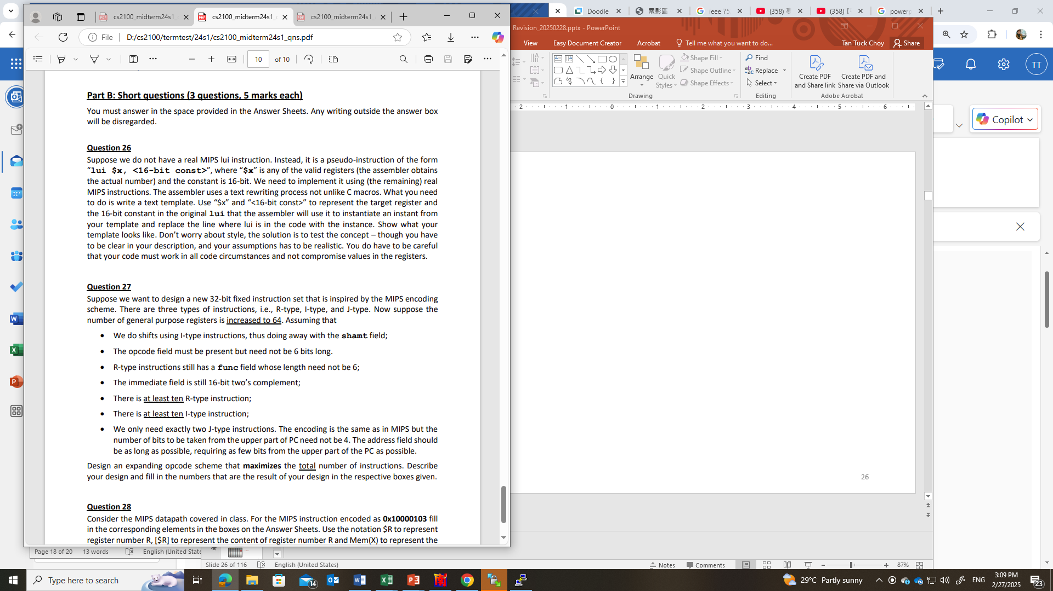
AY2024/25 Semester 1
Eg: lui $t0, 0xABCD
$t0:
1010 1011 1100 1101 0000 0000 0000 0000
ori $x, $zero, <16-bit const>
ori $t0, $zero, 0xABCD
sll $x, $x, 16
sll $t0, $t0, 16

Slide 27
AY2024/25 Semester 1
Register field: 6 bits. We can then work out the constraint for the opcode field using the I-type instruction: it will need 16 bits for the immediate, 6 bits for rs and 6 bits for rt, leaving us 4 bits for the opcode.
If opcode is 4 bits, and the three registers of rs, rt and rd in the R-type instruction will take up 18 bits, and since we no longer have the shamt field, we will therefore have 10 bits for the func field.
So, if we keep 10 slots of the opcode for the “at least 10” I-type instructions, 2 slots for the J-type instructions, then we will have 4 slots for R-type instructions. Since each slot in the opcode can yield 2¹⁰ func codes, we have 4 x 2¹⁰ = 4096 R-type instructions.
Number of R-type instructions:
4096
Number of I-type instructions:
10
Max. total no. of instructions:
4096 + 10 + 2 = 4108

Slide 28
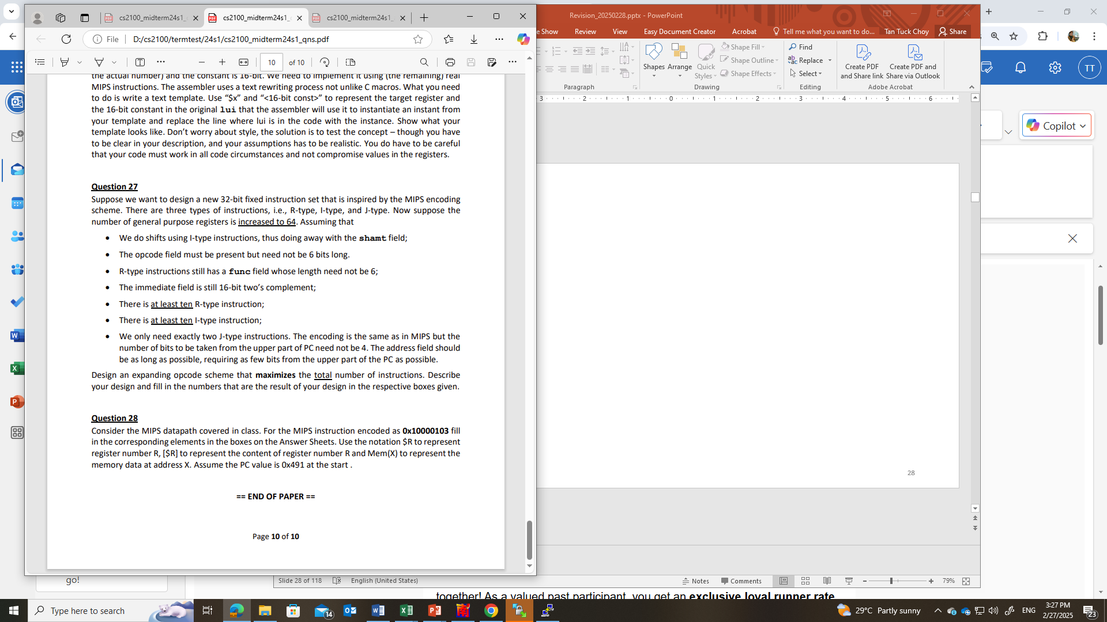
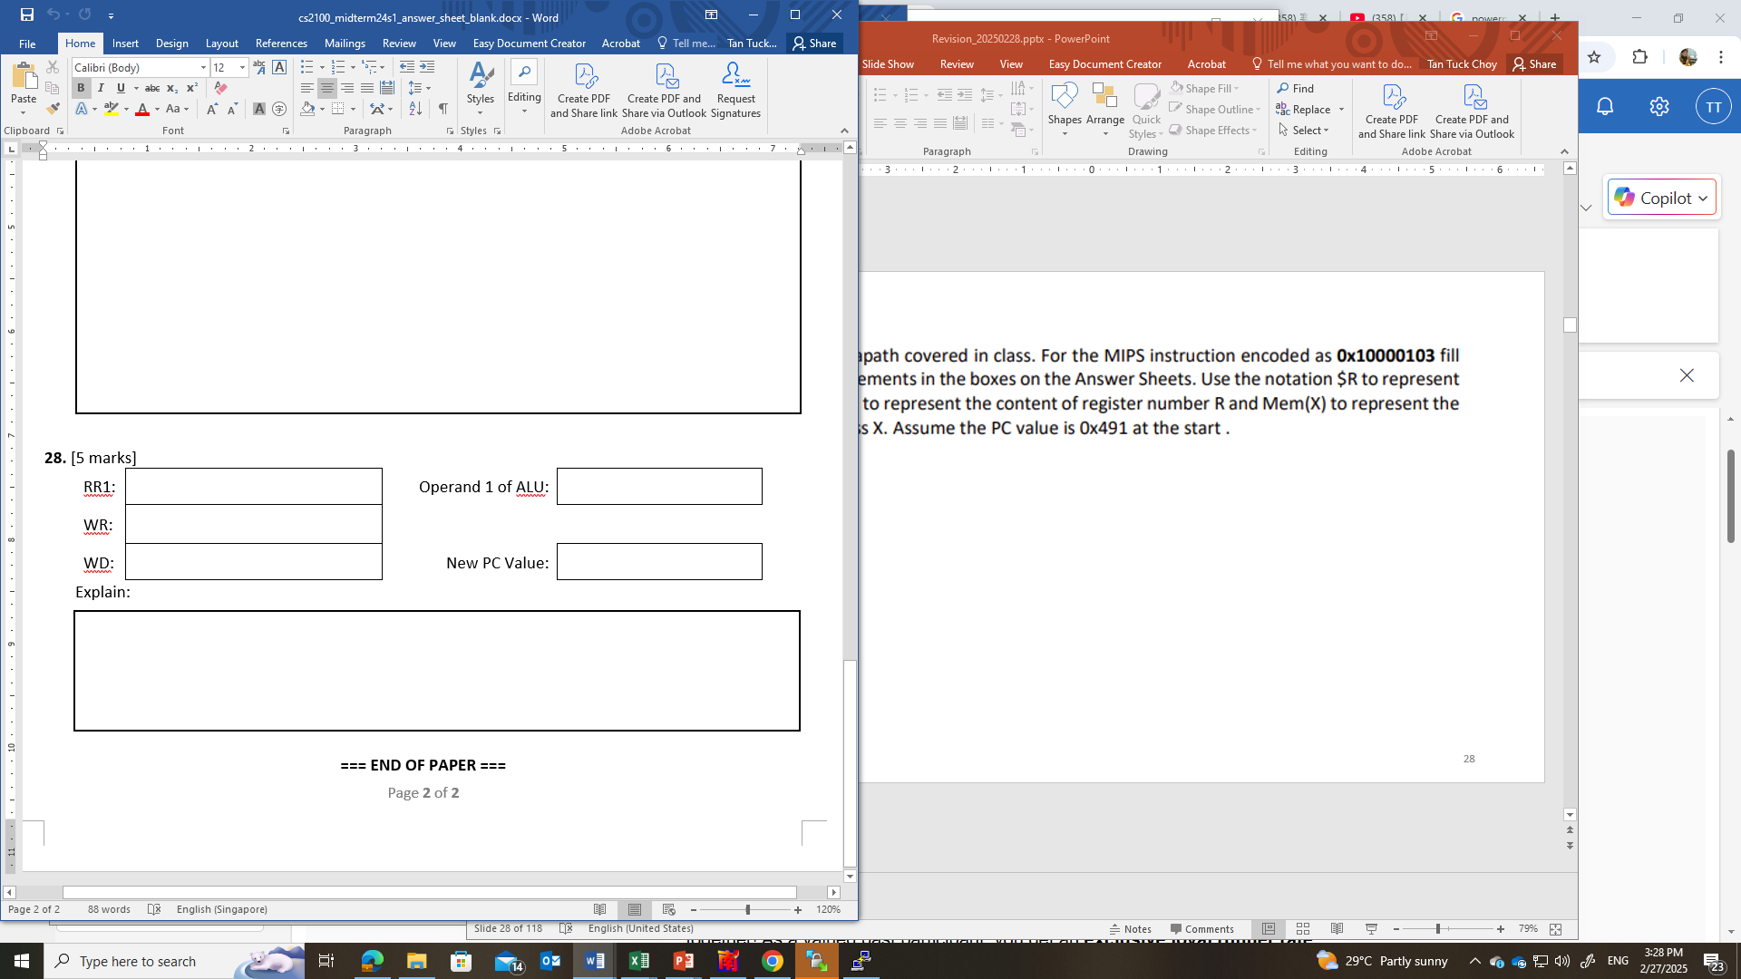
AY2024/25 Semester 1
$0
[$0] or 0
$0
0 or random value
0x8A1
0x10000103 = 0b000100 00000 00000 0000 0001 0000 0011 = beq $0, $0, 0x103
Since $0 == $0 is true, the branch is taken,
so new PC = (PC+4) + (Immed×4) = (0x491+4) + (0x103×4) = 0x8A1

Slide 29
AY2023/24 Semester 2

Slide 30
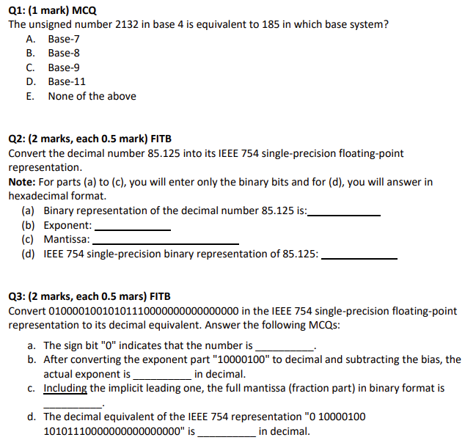
AY2023/24 Semester 2
2132₄ = 158₁₀ = 185₉
1010101.001
= 1.010101001 × 2⁶
10000101
01010100100000000000000
6 + 127 = 133 = 0b10000101
0x42AA4000
0 10000100 10101110000000000000000
positive
0b10000100 = 132; 132 – 127 = 5
5
1.1010111
1.1010111₂ × 2⁵ = 110101.11₂ = 53.75
53.75

Slide 31
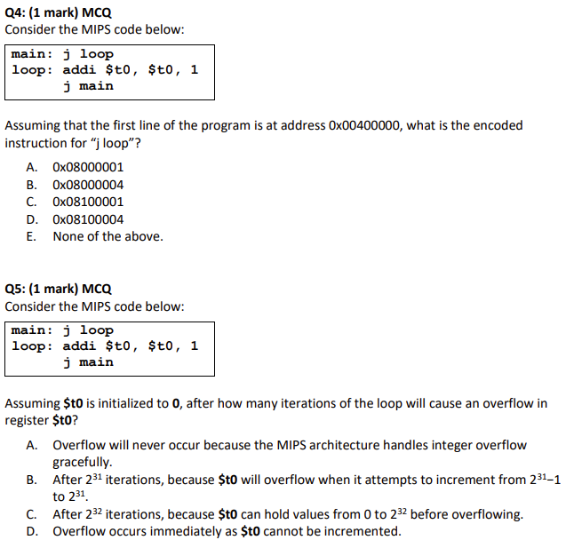
AY2023/24 Semester 2
Address = 0x00400004
= 0b0000 0000 0100 0000 0000 0000 0000 0100
Opcode of j = 0b000010
0b000010 0000 0100 0000 0000 0000 0000 01
= 0x08100001

Slide 32
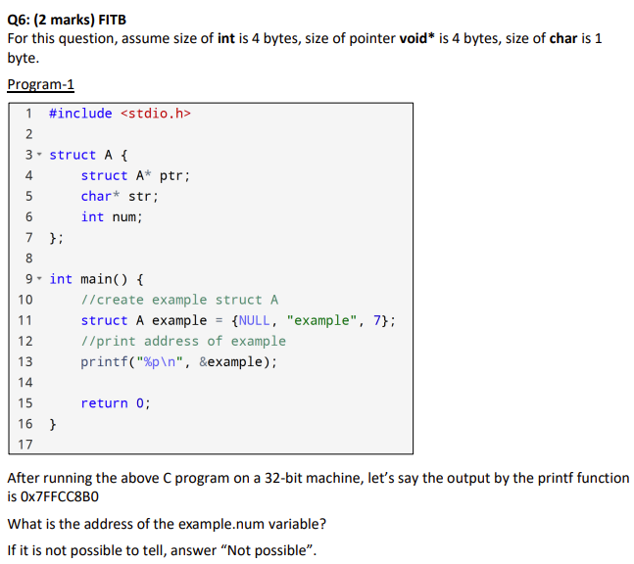
AY2023/24 Semester 2
0x7FFCC8B8

Slide 33
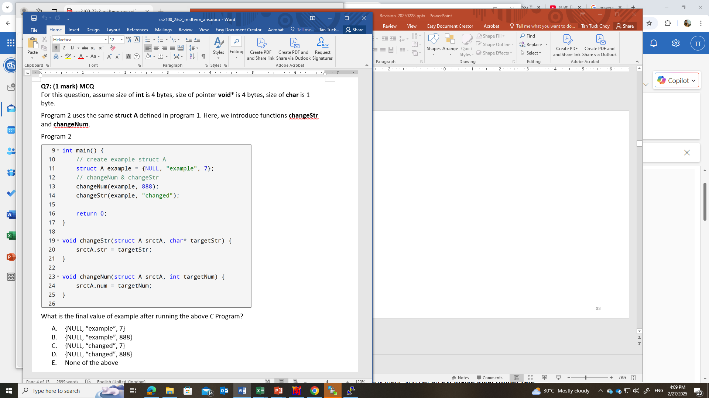
AY2023/24 Semester 2

Slide 34
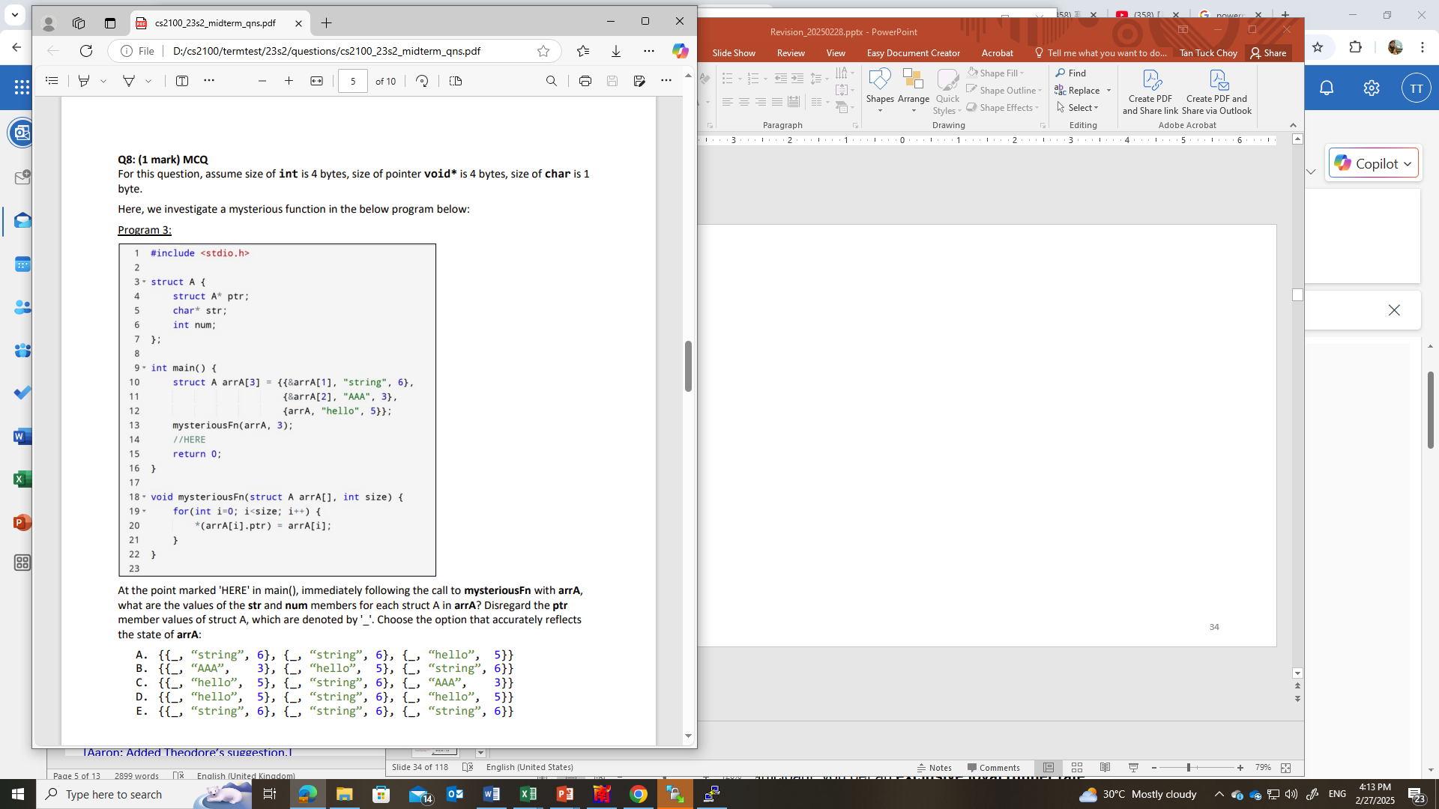
AY2023/24 Semester 2

Slide 35
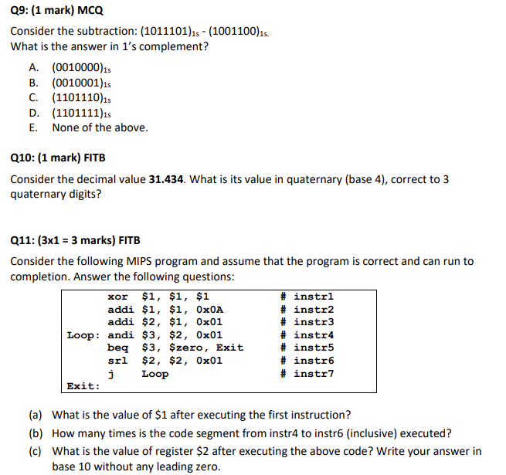
AY2023/24 Semester 2
1011101
+ 0110011
= 0010000
+ 1
= 0010001
0.434₁₀ = 0.1233₄ = 0.130₄
31.434₁₀ = 133.130₄
$3 always gets the LSB of the $2, $2 is 0b1011. Every iteration we right shift 1 bit of $2. Thus, after two iterations, the LSB is 0, we will stop the iteration.
0
2
2

Slide 36
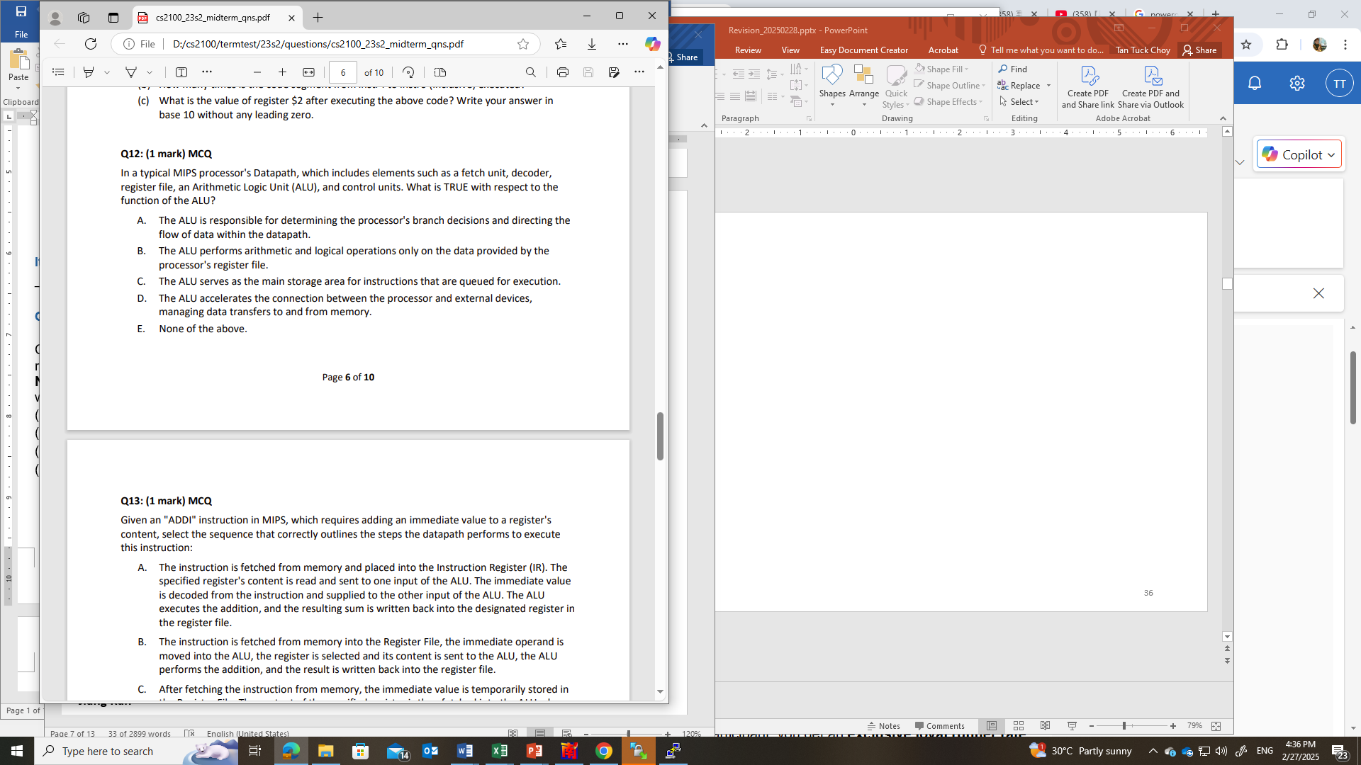
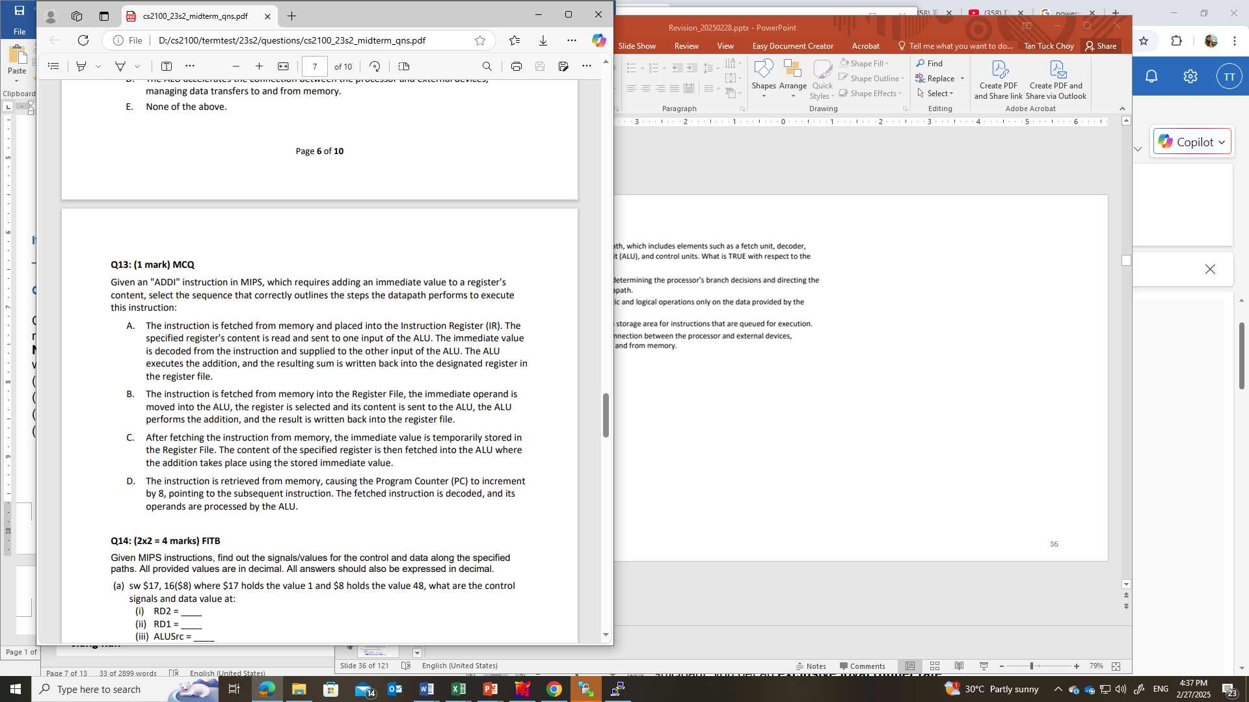
AY2023/24 Semester 2
(B) Not store in the Register File but in the instruction register.
(C) Immediate value is stored in the instruction not in the RF.
(D) Increment by 4, not 8.

Slide 37
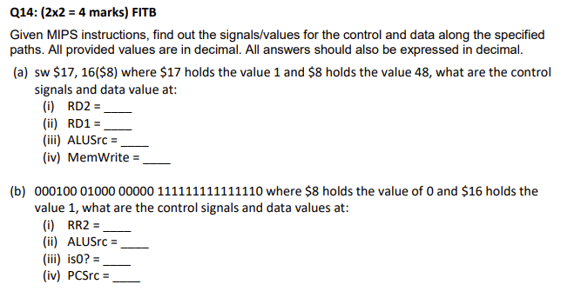
AY2023/24 Semester 2
1
48
1
1
0
0
beq $8 $0, -2
1
1

Slide 38
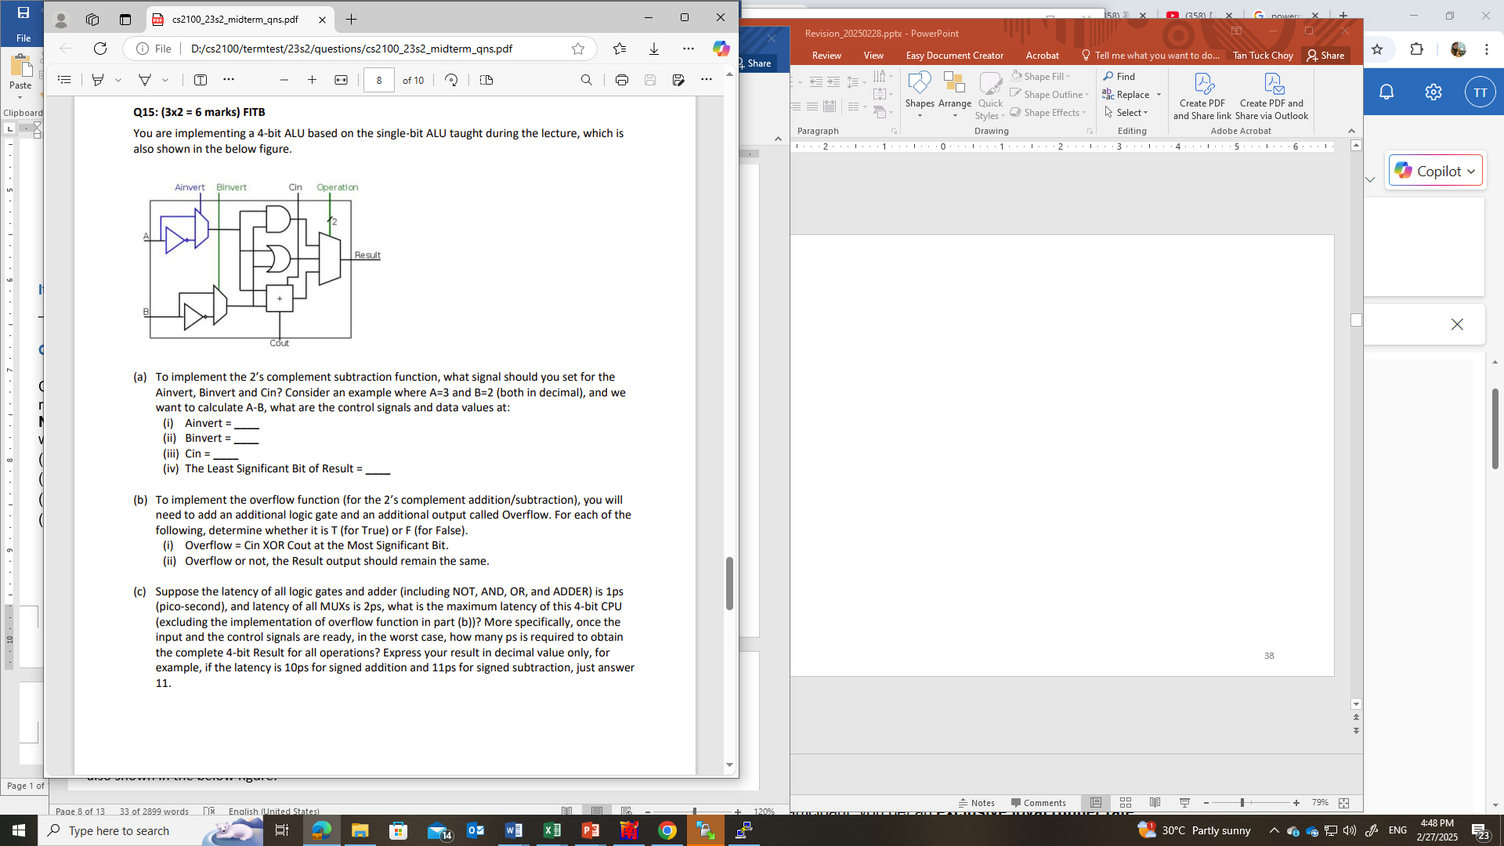
AY2023/24 Semester 2
0
1
1
1
T
T
It takes 4ps to output the LSB Cout, hence 6ps to get MSB Cin, 7 ps to get MSB ADDER output, 9ps to get MSB Result.
9

Slide 39
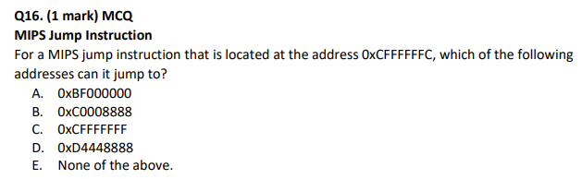
AY2023/24 Semester 2
If PC = 0xCFFFFFFC, then PC+4 = 0xD0000000, and hence it can only jump to addresses that start with 0b1101.

Slide 40
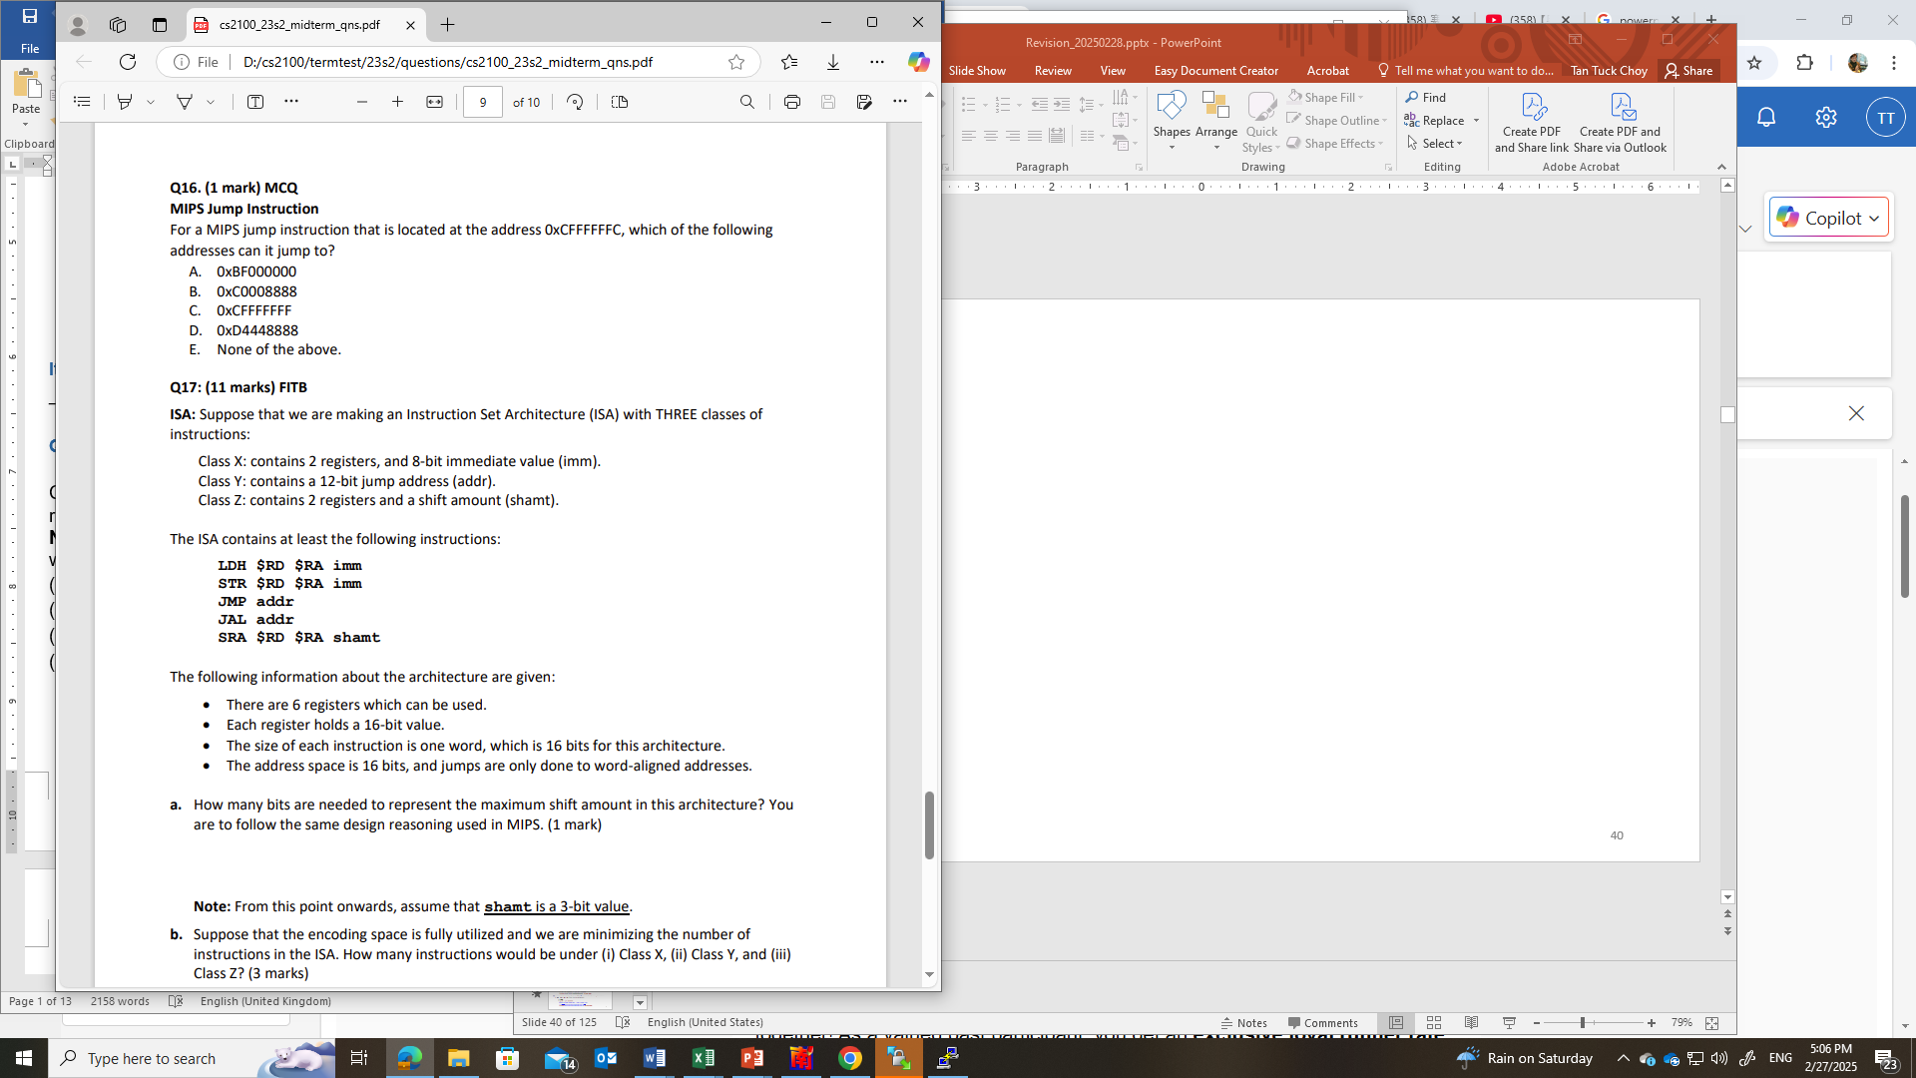
AY2023/24 Semester 2
4 bits.
In MIPS, the shamt is 5 bits for 32-bit registers. Following the same reasoning, we have 4 bits for the maximum shift amount as the registers here are 16-bit long.

Slide 41
AY2023/24 Semester 2
Class X has at least 2 instructions (LDH, STR); Class Y has at least 2 instructions (JMP, JAL); Class Z has at least 1 instruction (SRA). Since there are 6 registers, we need to use 3 bits to represent a register. This leaves us with the following number of bits for the opcodes:
Class X: 2 bits for opcode, 6 bits for the two registers, 8 bits for imm
Class Y: 4 bits for opcode, 12 bits for addr
Class Z: 7 bits for opcode, 6 bits for the two registers, 3 bits for shamt
Class X: 3
Class Y: 3
Class Z: 8
To minimize the number of instructions, we give class X the most number of opcodes possible, which is 3. For example, we give X the opcodes 01,10,11; leaving the opcodes starting from 00 for classes Y/Z.
We then give class Y the most number of opcodes possible. In this example, we can give 3 opcodes (eg: 0001/0010/0011) to class Y; leaving the opcodes starting from 0000 for class Z.
Class Z would have opcodes of the form 0000xxx, which adds up to 8 opcodes.

Slide 42
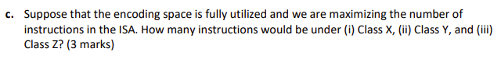
AY2023/24 Semester 2
Class X: 2
Class Y: 2
Class Z: 48
To maximize the number of instructions, we restrict classes X/Y as much as possible, giving a maximum number of opcodes for classes Z.
Note that class X has at least two instructions. Reserve opcodes 00 and 01 for those instructions. Classes Y & Z will have opcodes starting with 10/11.
Note that class Y has at least 2 instructions. Reserve opcode 1000/1001 for class Y.
This leaves the following opcodes for class Z:
1010xxx : 8 opcodes
1011xxx : 8 opcodes
11xxxxx : 32 opcodes
For a total of 48 opcodes for class Z.

Slide 43
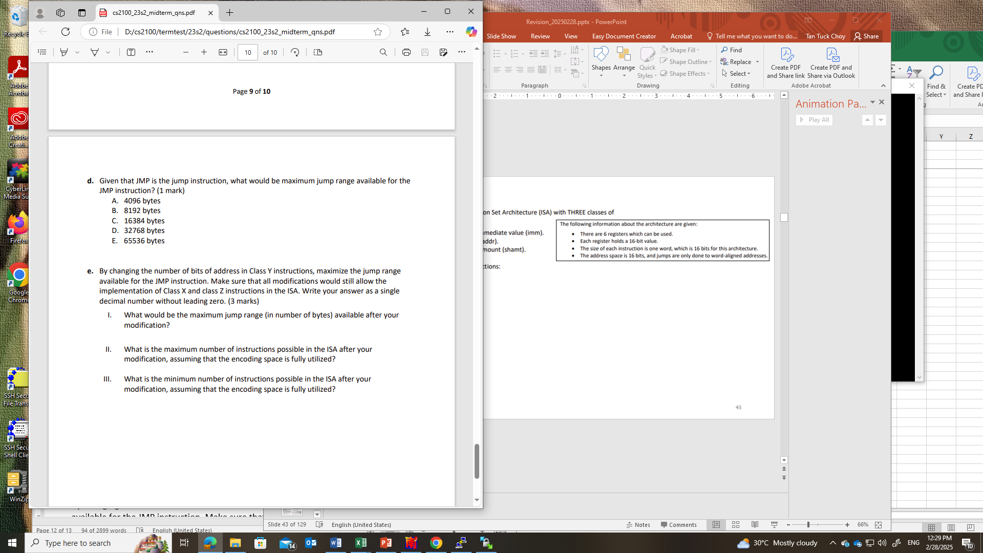
AY2023/24 Semester 2
Since the jumps are word-aligned to 16 bits (2 bytes), we can take the address and pad one zero to the end. This results in 13-bit addresses, which translates to a jump range of 8192 bytes.

Slide 44
AY2023/24 Semester 2
If we were to make the addr 14 bits, we would not be able to fit all the instructions into 16 bits. To show this, suppose we make addr into 14 bits. Then we only have 2 bits for the opcode. Since both classes X and Y have 2 bits of opcode, and each of them have at least 2 instructions, the encoding space would have no space for class Z instructions.
We can make addr into at most 13 bits. One possible opcode combination for this is:
Class X: 00/01
Class Y: 100/101
Class Z: 11xxxxx
This would result in a jump range of 13+1 = 14 bits, which is 2¹⁴ or 16384 bytes
Maximum: 2 (class X) + 2 (class Y) + 2×2­⁴ (class Z) = 36 opcodes.
Minimum: 2 (class X) + 3 (class Y) + 2­⁴ (class Z) = 21 opcodes.
From part (b):
Class X: 2-bit opcode
Class Y: 4-bit opcode
Class Z: 7-bit opcode
16384
36
21

Slide 46
END OF FILE

